Slide 1

AI

Slide 2
What is AI
Artificial Intelligence is an approach to make a computer, a robot, or a product to think how smart human think. AI is a study of how human brain think, learn, decide and work, when it tries to solve problems. And finally this study outputs intelligent software system. The aim of AI is to improve computer functions which are related to human knowledge, for example, reasoning, learning, and problem-solving.

Slide 3
Ancient Computers

Slide 4
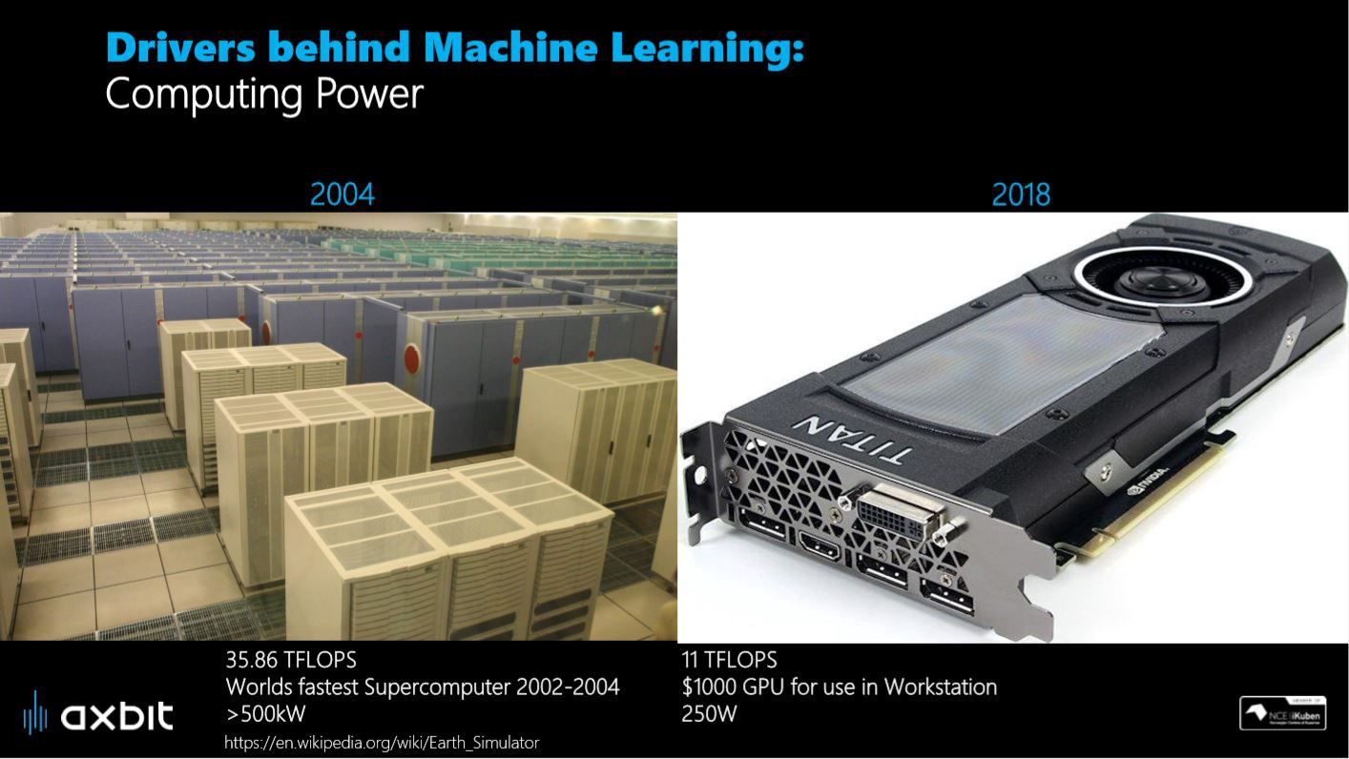

Slide 5
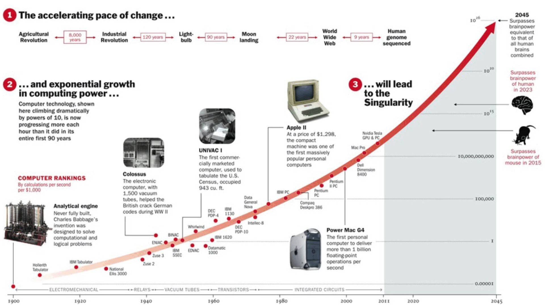

Slide 6

Introduction to AI
Artificial Intelligence was born in attempts to imitate human intelligence. Take a look at it’s brief history. It’s not yet clear whether it is possible to mimic human mind, but we can definitely re-create some of it’s functions. At the same time the whole field of Cognitive Sciences received broad attention.
At the same time it raised a lot of concerns in society. Problems with machines taking over the world are somewhat overblown, but job displacement is a real concern right now. Take a look at Artificial vs Natural Intelligence to get a better idea in which dimensions computers are superior to us.

Slide 7
History of AI
The idea of artificial mechanisms that imitate life dates back to the Aristotle, Plato and sometimes even earlier. Since 19th century people have started to actual;ly design and implement them. First attempts were more like mechanical calculators, but they’ve already provided solutions to some problems which usually require thinking. However, “officially” AI as a field of study arrived only in 1956.

Slide 8
History of AI: Dartmouth Workshop 1956
In the 1956 McCarthy has organized the Dartmouth Summer Research Project and invited Minsky, Shannon, Newell, Simon and others. They have discussed the possibility of creating the “thinking” machines for roughly 8 weeks. While some of them remained skeptical about it, Artificial Intelligence started to receive more and more public attention. In the meantime the new wave of cognitive approach to psychology, linguistics and other fields emerged.

Slide 9
Neural Networks are Rising Again
In the 90s came first successful commercial applications of neural networks in character and speech recognition. In 1997 IBM developed special computer Deep Blue that beat world chess champion Garry Kasparov. By 2010 were developed first successful self-driving cars and industrial robots.
An important paradigm shift emerged: more and more scientists have started to treat intelligence as an ability to behave profitably. Internal mechanisms became not as important.
Since then neural networks gradually outperformed humans in many tasks like recognition, classification and prediction. Deep Learning became a mainstream in AI research and proved to be very fruitful. While debates about possibilities of simulation of human thought are still going, we just don’t have any substantial arguments for any of those points.

Slide 10
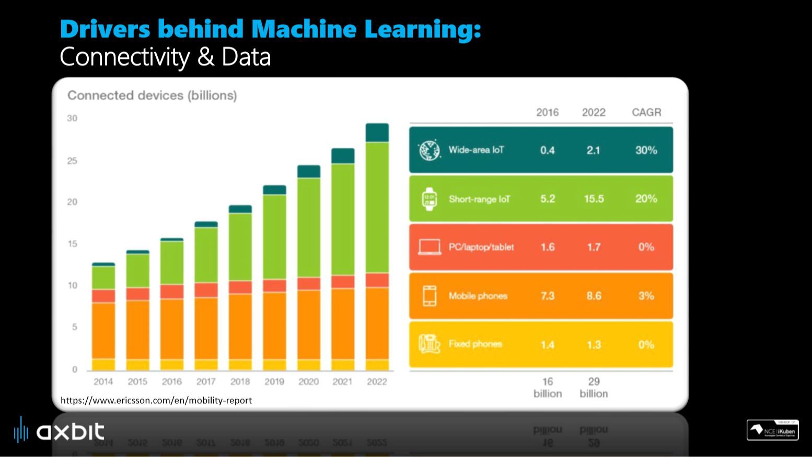

Slide 11
Applications of AI

Slide 12
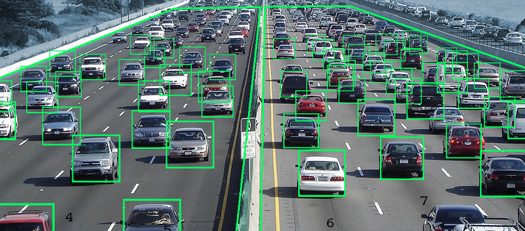

Slide 13


Slide 14

Facial Recognition

Slide 15
Future Aspects of AI

Slide 16

Applications of Machine Learning
Notes:
Within certain areas, the technology has caught up to, and even surpassed the hype. For example, within image recognition, the task of identifying objects and extracting information from images, AI is now going beyond human level performance (i.e., machines are actually getting better than humans in identifying objects and images).

Slide 17
1. Image Recognition

Slide 18
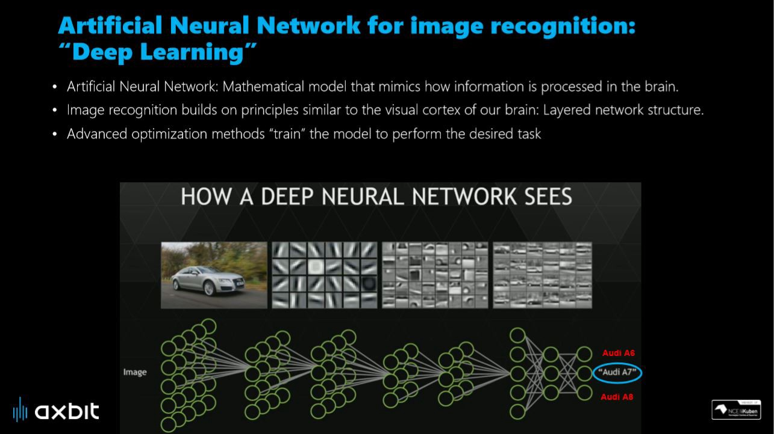

Slide 19
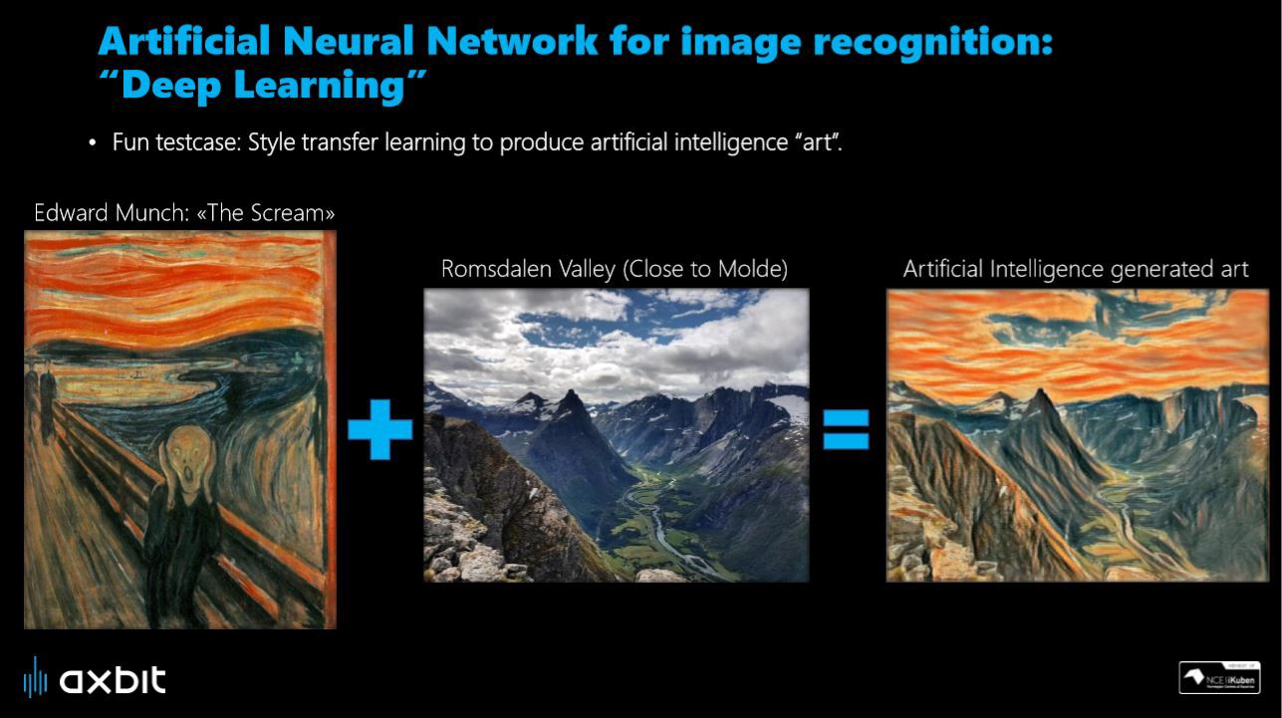

Slide 20

Speech Recognition
Notes:
While using Google, we get an option of "Search by voice," it comes under speech recognition, and it's a popular application of machine learning.
Speech recognition is a process of converting voice instructions into text, and it is also known as "Speech to text", or "Computer speech recognition." At present, machine learning algorithms are widely used by various applications of speech recognition. Google assistant, Siri, Cortana, and Alexa are using speech recognition technology to follow the voice instructions.

Slide 21
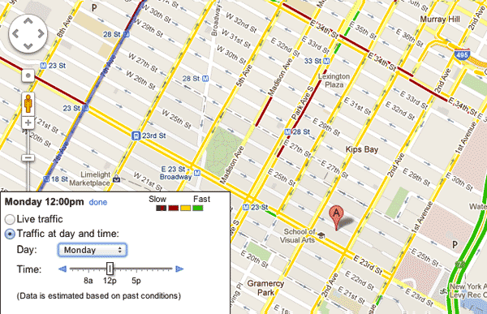
Google Traffic Prediction
Notes:
If we want to visit a new place, we take help of Google Maps, which shows us the correct path with the shortest route and predicts the traffic conditions.
It predicts the traffic conditions such as whether traffic is cleared, slow-moving, or heavily congested with the help of two ways:
Real Time location of the vehicle form Google Map app and sensors
Average time has taken on past days at the same time.
Everyone who is using Google Map is helping this app to make it better. It takes information from the user and sends back to its database to improve the performance.

Slide 22
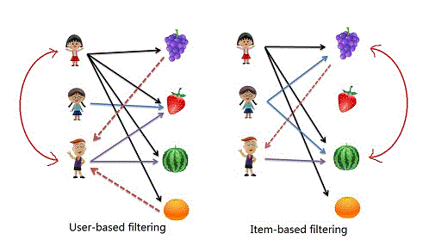
Product Recommendations
Notes:
Collabrative filtering- ollaborative filtering is a technique that can filter out items that a user might like on the basis of reactions by similar users.
It works by searching a large group of people and finding a smaller set of users with tastes similar to a particular user. It looks at the items they like and combines them to create a ranked list of suggestions.
There are many ways to decide which users have similar Choices and combine their choices to create a list of recommendations.

Slide 23

Virtual Personal Assistant
Notes:
We have various virtual personal assistants such as Google assistant, Alexa, Cortana, Siri. As the name suggests, they help us in finding the information using our voice instruction. These assistants can help us in various ways just by our voice instructions such as Play music, call someone, Open an email, Scheduling an appointment, etc.
These virtual assistants use machine learning algorithms as an important part.
These assistant record our voice instructions, send it over the server on a cloud, and decode it using ML algorithms and act accordingly.

Slide 24
Setting up Environment of Python

Slide 25

Installing Python 3.4.3
https://www.python.org/downloads/

Slide 26
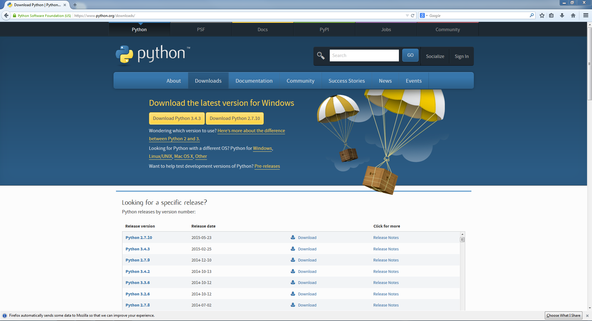
Go to: https://www.python.org/downloads/
Click the “Download Python 3.4.3 Button”

Slide 27
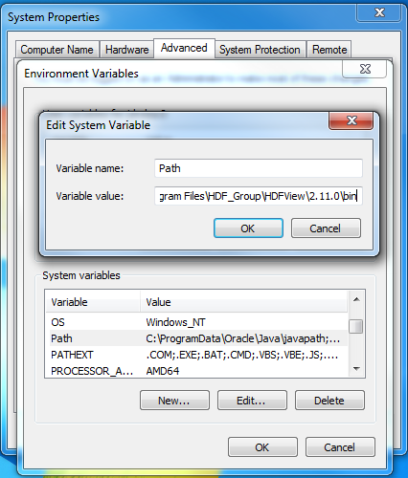
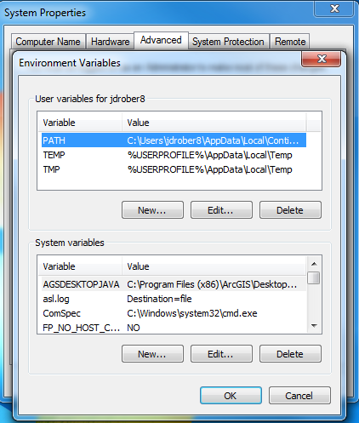
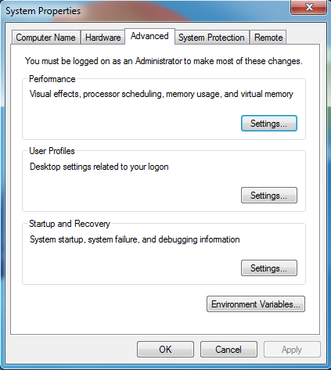
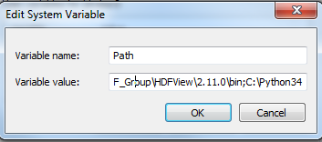
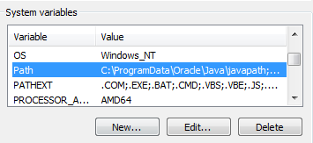
Setting your environment path
Scroll to the very end of this line of text…
Click “Ok” to all open properties windows
…and add the text: “;C:\Python34” to the end
Click on the variable “Path” so that it is highlighted, and then click “Edit..”
Go to the “System Variables” window, and scroll down until you find the “Path” variable
Click the “Environment Variables” Button

Slide 28

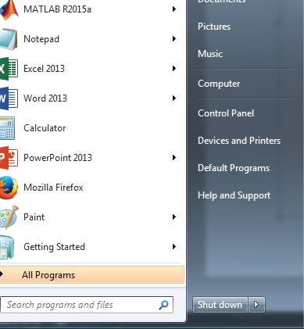
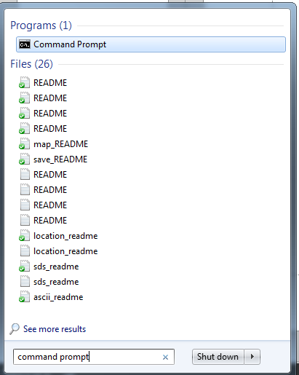
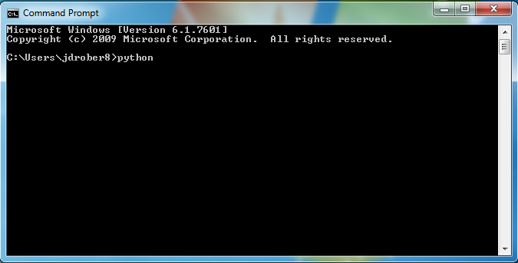
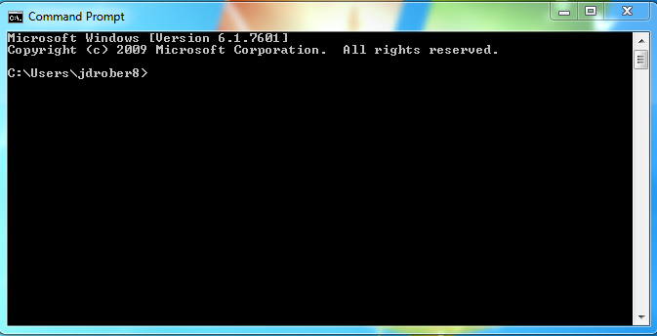
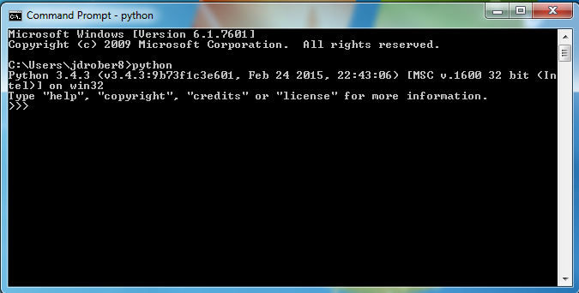
Test Python 3.4.3 installation
Open the start menu:
Open Command Prompt
Type “python”…
…and hit Enter
If your command prompt now says: “Python 3.4.3”, you’ve completed the tutorial correctly! If not, you may have missed something…
Search here for “Command prompt”

Slide 29
Installing Python 3 Packages
Python Package Index: Pip command
https://pypi.python.org/pypi/

Slide 30
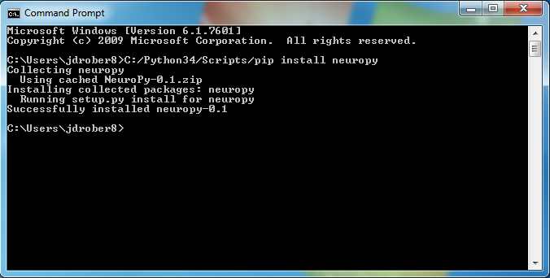
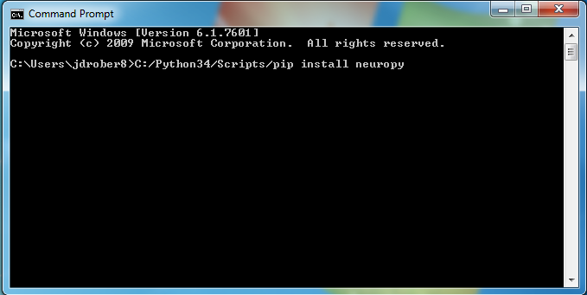
Open the Command Prompt
Many python packages are available for installation through the simple “pip” command.
Try the following command:
C:/Python34/Scripts/pip install “name-of-package” (i.e. NeuroPy)
And hit Enter.

Slide 31
Introduction to Python Programming

Slide 32

Introduction to Python
Python is a high-level programming language
Open source and community driven
“Batteries Included”
a standard distribution includes many modules
Dynamic typed
Source can be compiled or run just-in-time
Similar to perl, tcl, ruby.

Slide 33
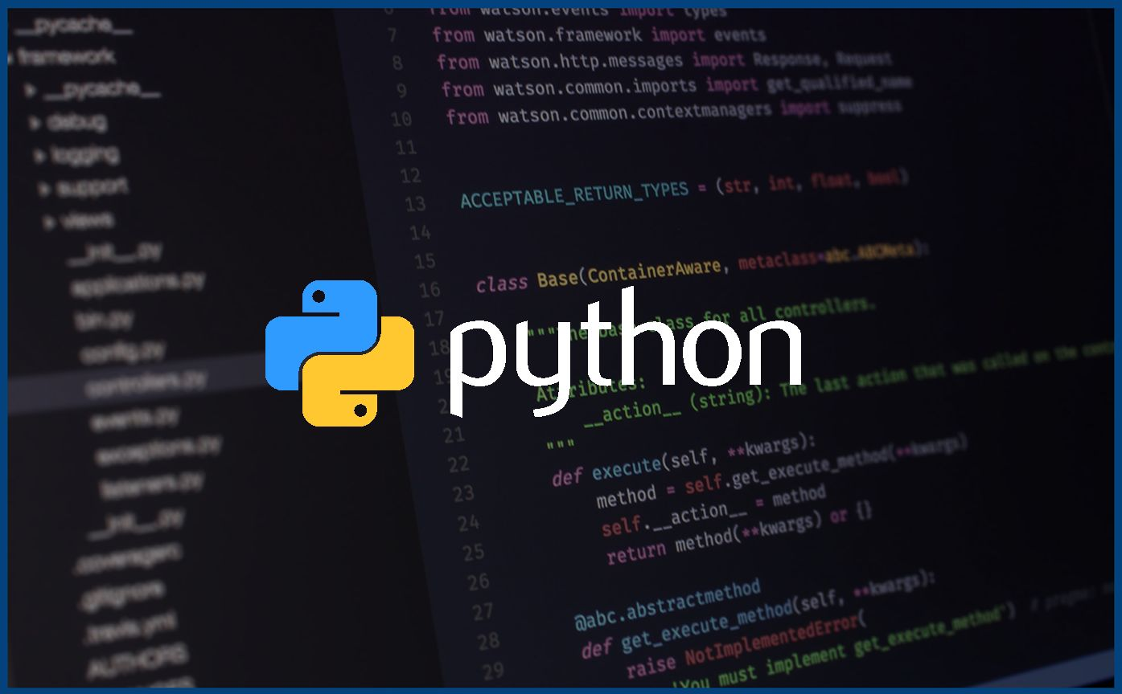
Why Python?
Unlike AML and Avenue, there is a considerable base of developers already using the language
“Tried and true” language that has been in development since 1991
Can interface with the Component Object Model (COM) used by Windows
Can interface with Open Source GIS toolsets

Slide 34
Why not Visual Basic?
Visual Basic is still the method of configuring and customizing ArcMap
If you have a button on the toolbar, it’s VB
Python scripts can be placed in ArcToolbox
Python can be run from the command line without ArcMap or ArcCatalog being open
Using just the GIS Engine, lower overhead
Rapid prototyping, ease of authoring, etc.

Slide 35
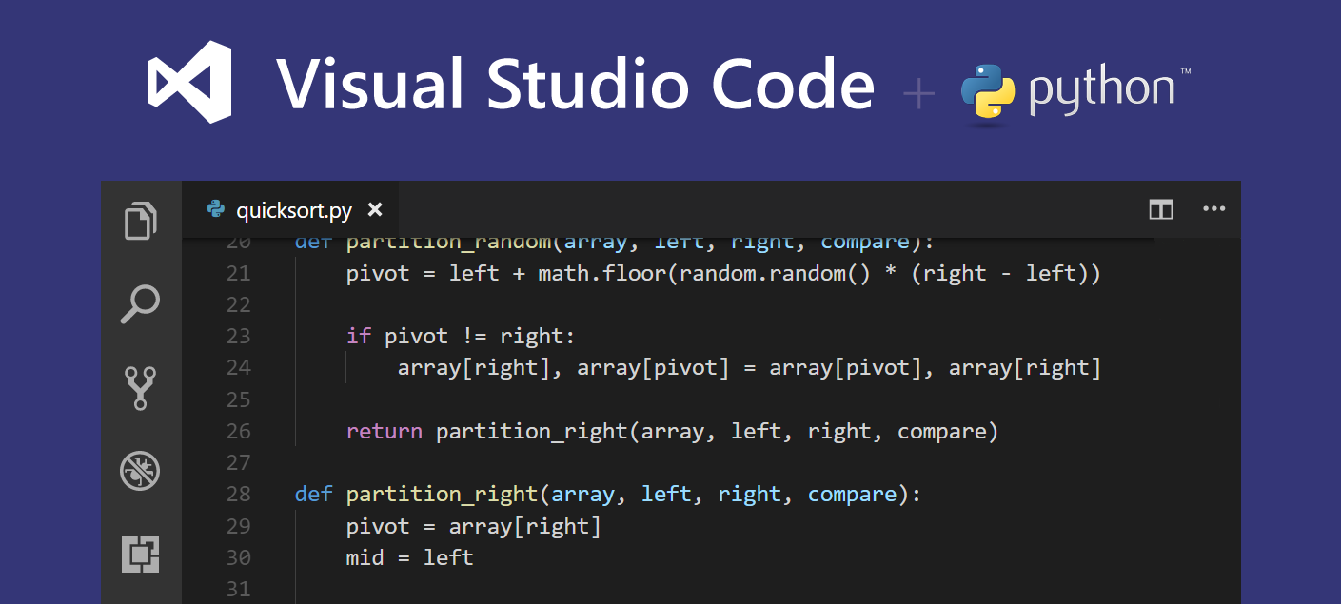

Slide 36
Python Interfaces
IDLE – a cross-platform Python development environment
PythonWin – a Windows only interface to Python
Python Shell – running 'python' from the Command Line opens this interactive shell
For the exercises, we'll use IDLE, but you can try them all and pick a favorite

Slide 37
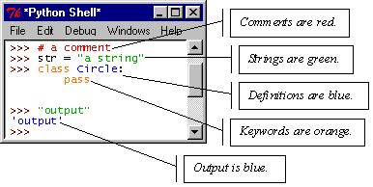
IDLE – Development Environment
IDLE helps you program in Python by:
color-coding your program code
debugging
auto-indent
interactive shell

Slide 38
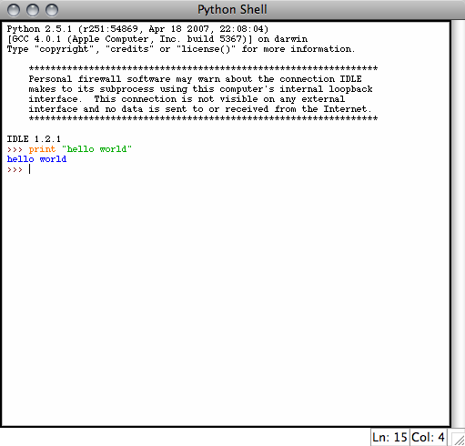
Example Python
Hello World
print “hello world”
Prints hello world to standard out
Open IDLE and try it out yourself
Follow along using IDLE

Slide 39
More than just printing
Python is an object oriented language
Practically everything can be treated as an object
“hello world” is a string
Strings, as objects, have methods that return the result of a function on the string

Slide 40
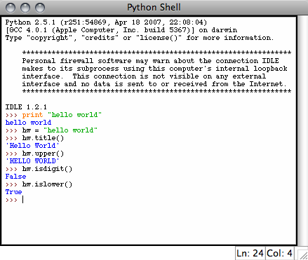
String Methods
Assign a string to a variable
In this case “hw”
hw.title()
hw.upper()
hw.isdigit()
hw.islower()

Slide 41
String Methods
The string held in your variable remains the same
The method returns an altered string
Changing the variable requires reassignment
hw = hw.upper()
hw now equals “HELLO WORLD”

Slide 42
Other Python Objects
Lists (mutable sets of strings)
var = [] # create list
var = [‘one’, 2, ‘three’, ‘banana’]
Tuples (immutable sets)
var = (‘one’, 2, ‘three’, ‘banana’)
Dictionaries (associative arrays or ‘hashes’)
var = {} # create dictionary
var = {‘lat’: 40.20547, ‘lon’: -74.76322}
var[‘lat’] = 40.2054
Each has its own set of methods

Slide 43
Lists
Think of a list as a stack of cards, on which your information is written
The information stays in the order you place it in until you modify that order
Methods return a string or subset of the list or modify the list to add or remove components
Written as var[index], index refers to order within set (think card number, starting at 0)
You can step through lists as part of a loop

Slide 44
List Methods
Adding to the List
var[n] = object
replaces n with object
var.append(object)
adds object to the end of the list
Removing from the List
var[n] = []
empties contents of card, but preserves order
var.remove(n)
removes card at n
var.pop(n)
removes n and returns its value

Slide 45
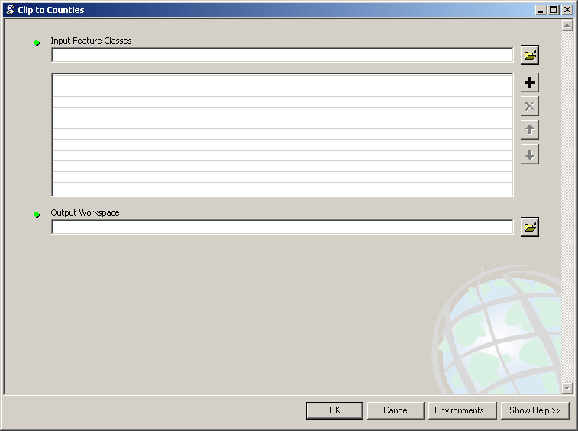
Lists in ArcToolbox
You will create lists:
Layers as inputs
Attributes to match
Arrays of objects
You will work with lists:
List of field names
List of selected features

Slide 46
Tuples
Like a list, tuples are iterable arrays of objects
Tuples are immutable – once created, unchangeable
To add or remove items, you must redeclare
Example uses of tuples
County Names
Land Use Codes
Ordered set of functions

Slide 47
Dictionaries
Dictionaries are sets of key & value pairs
Allows you to identify values by a descriptive name instead of order in a list
Keys are unordered unless explicitly sorted
Keys are unique:
var[‘item’] = “apple”
var[‘item’] = “banana”
print var[‘item’] prints just banana

Slide 48
Indentation and Blocks
Python uses whitespace and indents to denote blocks of code
Lines of code that begin a block end in a colon:
Lines within the code block are indented at the same level
To end a code block, remove the indentation
You'll want blocks of code that run only when certain conditions are met

Slide 49
Conditional Branching
if and else
if variable == condition: #do something based on v == c
else:
#do something based on v != c
elif allows for additional branching
if condition:
elif another condition:
…
else: #none of the above

Slide 50
Looping with For
For allows you to loop over a block of code a set number of times
For is great for manipulating lists:
a = ['cat', 'window', 'defenestrate'] for x in a: print x, len(x)
Results:
cat 3
window 6
defenestrate 12

Slide 51
Looping with For
We could use a for loop to perform geoprocessing tasks on each layer in a list
We could get a list of features in a feature class and loop over each, checking attributes
Anything in a sequence or list can be used in a For loop
Just be sure not to modify the list while looping

Slide 52
Modules
Modules are additional pieces of code that further extend Python’s functionality
A module typically has a specific function
additional math functions, databases, network…
Python comes with many useful modules
arcgisscripting is the module we will use to load ArcGIS toolbox functions into Python

Slide 53
Modules
Modules are accessed using import
import sys, os # imports two modules
Modules can have subsets of functions
os.path is a subset within os
Modules are then addressed by modulename.function()
sys.argv # list of arguments
filename = os.path.splitext("points.txt")
filename[1] # equals ".txt"

Slide 54
Files
Files are manipulated by creating a file object
f = open("points.txt", "r")
The file object then has new methods
print f.readline() # prints line from file
Files can be accessed to read or write
f = open("output.txt", "w")
f.write("Important Output!")
Files are iterable objects, like lists

Slide 55
Error Capture
Check for type assignment errors, items not in a list, etc.
Try & Except
try:
a block of code that might have an error
except: code to execute if an error occurs in "try"
Allows for graceful failure – important in ArcGIS

Slide 56
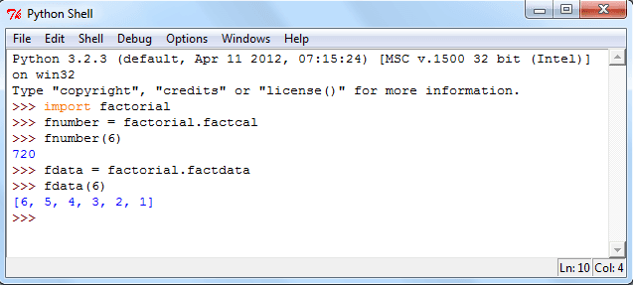
Modules in Python
A Module Allows you to logically organuze your python code. Grouoping related code into a module makes the code easier to understand and use. A module is a python object with arbitrarily named attributes that you can bind and reference.
A

Slide 57
Python OOPS
Classes and Objects; Inheritance
Except where otherwise noted, this work is licensed under: http://creativecommons.org/licenses/by-nc-sa/3.0

Slide 58
OOP, Defining a Class
Python was built as a procedural language
OOP exists and works fine, but feels a bit more "tacked on"
Java probably does classes better than Python (gasp)
Declaring a class:
class name:
statements
Notes:
58

Slide 59
Fields
point.py
1 2 3 | class Point: x = 0 y = 0
name = value
Example:
class Point:
x = 0
y = 0
# main
p1 = Point()
p1.x = 2
p1.y = -5
can be declared directly inside class (as shown here) or in constructors (more common)
Python does not really have encapsulation or private fields
relies on caller to "be nice" and not mess with objects' contents
Notes:
59

Slide 60
Using a Class
point_main.py
1 2 3 4 5 6 7 8 9 10 | from Point import * # main p1 = Point() p1.x = 7 p1.y = -3 ... # Python objects are dynamic (can add fields any time!) p1.name = "Tyler Durden"
import class
client programs must import the classes they use

Slide 61
Object Methods
def name(self, parameter, ..., parameter):
statements
self must be the first parameter to any object method
represents the "implicit parameter" (this in Java)
must access the object's fields through the self reference
class Point:
def translate(self, dx, dy):
self.x += dx
self.y += dy
...
Notes:
61

Slide 62
"Implicit" Parameter (self)
Java: this, implicit
public void translate(int dx, int dy) {
x += dx; // this.x += dx;
y += dy; // this.y += dy;
}
Python: self, explicit
def translate(self, dx, dy):
self.x += dx
self.y += dy
Exercise: Write distance, set_location, and distance_from_origin methods.
Notes:
62

Slide 63
Calling Methods
A client can call the methods of an object in two ways:
(the value of self can be an implicit or explicit parameter)
1) object.method(parameters)
or
2) Class.method(object, parameters)
Example:
p = Point(3, -4)
p.translate(1, 5)
Point.translate(p, 1, 5)

Slide 64
Constructors
def __init__(self, parameter, ..., parameter):
statements
a constructor is a special method with the name __init__
Example:
class Point:
def __init__(self, x, y):
self.x = x
self.y = y
...
How would we make it possible to construct a Point() with no parameters to get (0, 0)?
Notes:
64

Slide 65
toString and __str__
def __str__(self):
return string
equivalent to Java's toString (converts object to a string)
invoked automatically when str or print is called
Exercise: Write a __str__ method for Point objects that returns strings like "(3, -14)"
def __str__(self):
return "(" + str(self.x) + ", " + str(self.y) + ")"

Slide 66
Complete Point Class
point.py
1 2 3 4 5 6 7 8 9 10 11 12 13 14 15 16 17 18 19 20 21 | from math import * class Point: def __init__(self, x, y): self.x = x self.y = y def distance_from_origin(self): return sqrt(self.x * self.x + self.y * self.y) def distance(self, other): dx = self.x - other.x dy = self.y - other.y return sqrt(dx * dx + dy * dy) def translate(self, dx, dy): self.x += dx self.y += dy def __str__(self): return "(" + str(self.x) + ", " + str(self.y) + ")"

Slide 67
Operator Overloading
Operator overloading: You can define functions so that Python's built-in operators can be used with your class.
See also: http://docs.python.org/ref/customization.html
Operator | Class Method
- | __neg__(self, other)
+ | __pos__(self, other)
* | __mul__(self, other)
/ | __truediv__(self, other)
Operator | Class Method
== | __eq__(self, other)
!= | __ne__(self, other)
< | __lt__(self, other)
> | __gt__(self, other)
<= | __le__(self, other)
>= | __ge__(self, other)
- | __neg__(self)
+ | __pos__(self)
Unary Operators

Slide 68
Generating Exceptions
raise ExceptionType("message")
useful when the client uses your object improperly
types: ArithmeticError, AssertionError, IndexError, NameError, SyntaxError, TypeError, ValueError
Example:
class BankAccount:
...
def deposit(self, amount):
if amount < 0:
raise ValueError("negative amount")
...
Notes:
68

Slide 69
Inheritance
class name(superclass):
statements
Example:
class Point3D(Point): # Point3D extends Point
z = 0
...
Python also supports multiple inheritance
class name(superclass, ..., superclass):
statements
(if > 1 superclass has the same field/method, conflicts are resolved in left-to-right order)
Notes:
69

Slide 70
Calling Superclass Methods
methods: class.method(object, parameters)
constructors: class.__init__(parameters)
class Point3D(Point):
z = 0
def __init__(self, x, y, z):
Point.__init__(self, x, y)
self.z = z
def translate(self, dx, dy, dz):
Point.translate(self, dx, dy)
self.z += dz
Notes:
70

Slide 71
How to Deploy models to Production
We would create a web-service that can be queried to obtain the predictions from a machine learning model.

Slide 72
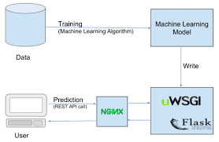
Steps for Deploying the Model-
Training the Machine Learning Model on Local Machine
Wrapping the Inference Logic into an Flask, AWS ec2, Tornado Application.
Using docker to containerize the application.
Hosting the Docker container on an AWS ec2 instance and consuming the Web Service.

Slide 73
Outline
Linear Algebra Basics
Matrix Calculus
Singular Value Decomposition (SVD)
Eigenvalue Decomposition
Low-rank Matrix Inversion

Slide 74
Basic concepts
Vector in R^{n} is an ordered set of n real numbers.
e.g. v = (1,6,3,4) is in R⁴
A column vector:
A row vector:
m-by-n matrix is an object in R^{mxn} with m rows and n columns, each entry filled with a (typically) real number:

Slide 75
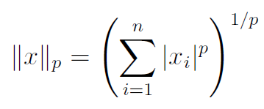
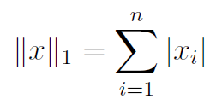
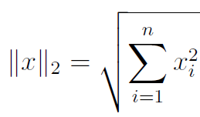
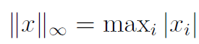
Basic concepts
Vector norms: A norm of a vector ||x|| is informally a measure of the “length” of the vector.
Common norms: L₁, L₂ (Euclidean)
L_{infinity}

Slide 76
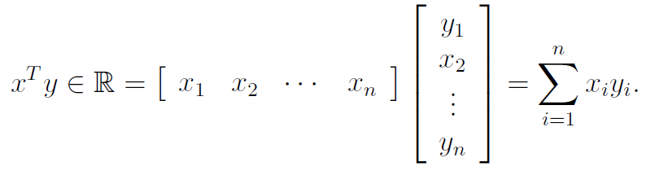
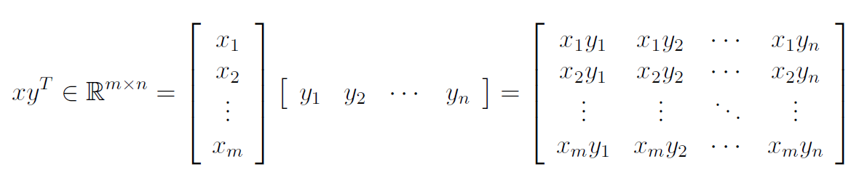
Basic concepts
We will use lower case letters for vectors The elements are referred by x_{i}.
Vector dot (inner) product:
Vector outer product:
If u•v=0, ||u||₂ != 0, ||v||₂ != 0 → u and v are orthogonal
If u•v=0, ||u||₂ = 1, ||v||₂ = 1 → u and v are orthonormal

Slide 77
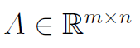
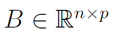
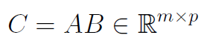
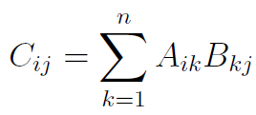
Basic concepts
We will use upper case letters for matrices. The elements are referred by Ai,j.
Matrix product:
e.g.

Slide 78
Special matrices
diagonal
upper-triangular
tri-diagonal
lower-triangular
I (identity matrix)

Slide 79
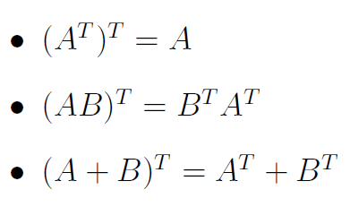
Basic concepts
Transpose: You can think of it as
“flipping” the rows and columns
OR
“reflecting” vector/matrix on line
e.g.
Notes:
A matrix has an inverse if and only if it is both square and non-degenerate. This inverse is unique. The inverse of an orthogonal matrix is its transpose. These are the only matrices whose inverses are the same as their transpositions.

Slide 80
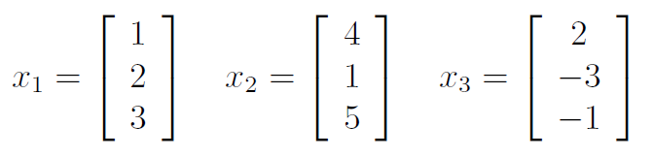
Linear independence
A set of vectors is linearly independent if none of them can be written as a linear combination of the others.
Vectors v₁,…,v_{k} are linearly independent if c₁v₁+…+c_{k}v_{k} = 0 implies c₁=…=c_{k}=0
e.g.
(u,v)=(0,0), i.e. the columns are linearly independent.
x3 = −2x1 + x2

Slide 81
Span of a vector space
If all vectors in a vector space may be expressed as linear combinations of a set of vectors v₁,…,v_{k}, then v₁,…,v_{k} spans the space.
The cardinality of this set is the dimension of the vector space.
A basis is a maximal set of linearly independent vectors and a minimal set of spanning vectors of a vector space
e.g.
(0,0,1)
(0,1,0)
(1,0,0)

Slide 82
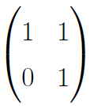
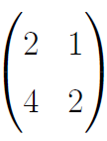
Rank of a Matrix
rank(A) (the rank of a m-by-n matrix A) is
The maximal number of linearly independent columns
=The maximal number of linearly independent rows
=The dimension of col(A)
=The dimension of row(A)
If A is n by m, then
rank(A)<= min(m,n)
If n=rank(A), then A has full row rank
If m=rank(A), then A has full column rank

Slide 83
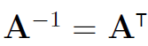
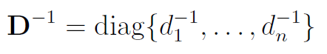
Inverse of a matrix
Inverse of a square matrix A, denoted by A⁻¹ is the unique matrix s.t.
AA⁻¹ =A⁻¹A=I (identity matrix)
If A⁻¹ and B⁻¹ exist, then
(AB)⁻¹ = B⁻¹A⁻¹,
(A^{T})⁻¹ = (A⁻¹)^{T}
For orthonormal matrices
For diagonal matrices
Notes:
To find the inverse of a 3x3 matrix, first calculate the determinant of the matrix. If the determinant is 0, the matrix has no inverse. Next, transpose the matrix by rewriting the first row as the first column, the middle row as the middle column, and the third row as the third column.

Slide 84
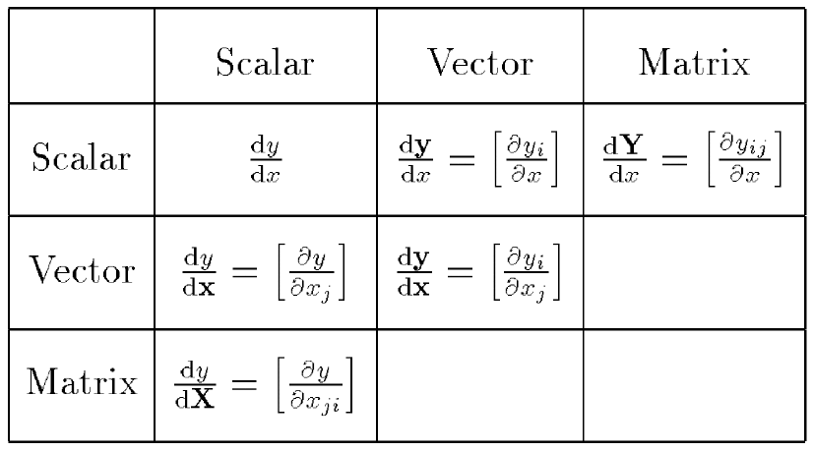
Dimensions
By Thomas Minka. Old and New Matrix Algebra Useful for Statistics

Slide 85
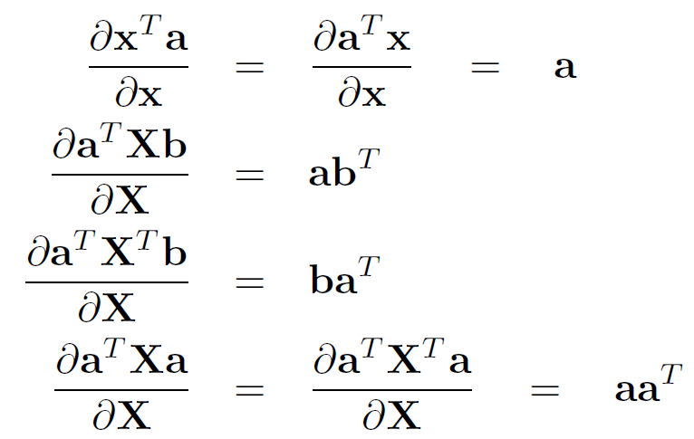
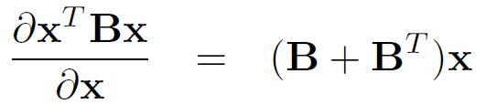
Examples
http://matrixcookbook.com/

Slide 86
Singular Value Decomposition (SVD)
Any matrix A can be decomposed as A=UDV^{T}, where
D is a diagonal matrix, with d=rank(A) non-zero elements
The fist d rows of U are orthogonal basis for col(A)
The fist d rows of V are orthogonal basis for row(A)
Applications of the SVD
Matrix Pseudoinverse
Low-rank matrix approximation

Slide 87
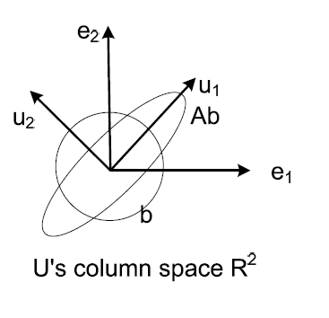
Eigen Value Decomposition
Any symmetric matrix A can be decomposed as A=UDU^{T}, where
D is diagonal, with d=rank(A) non-zero elements
The fist d rows of U are orthogonal basis for col(A)=row(A)
Re-interpreting Ab
First stretch b along the direction of u₁ by d₁ times
Then further stretch it along the direction of u₂ by d₂ times
Notes:
In linear algebra, an eigenvector or characteristic vector of a linear transformation is a nonzero vector that changes at most by a scalar factor when that linear transformation is applied to it. The corresponding eigenvalue is the factor by which the eigenvector is scaled. Wikipedia

Slide 88
Low-rank Matrix Inversion
In many applications (e.g. linear regression, Gaussian model) we need to calculate the inverse of covariance matrix X^{T}X (each row of n-by-m matrix X is a data sample)
If the number of features is huge (e.g. each sample is an image, #sample n<<#feature m) inverting the m-by-m X^{T}X matrix becomes an problem
Complexity of matrix inversion is generally O(n³)
Matlab can comfortably solve matrix inversion with m=thousands, but not much more than that

Slide 89
Low-rank Matrix Inversion
With the help of SVD, we actually do NOT need to explicitly invert X^{T}X
Decompose X=UDV^{T}
Then X^{T}X = VDU^{T}UDV^{T} = VD²V^{T}
Since V(D²)V^{T}V(D²)⁻¹V^{T}=I
We know that (X^{T}X )⁻¹= V(D²)⁻¹V^{T}
Inverting a diagonal matrix D² is trivial

Slide 90
Additional Python Resources
Python Homepage http://www.python.org/
Dive Into Python http://www.diveintopython.org/
Learning Python, 3rd Edition http://www.oreilly.com/catalog/9780596513986/
Getting Started Writing Geoprocessing Scripts Available on ESRI's suppor t page

